Slide 1
ISM 6642 · MACHINE LEARNING FOR BUSINESS APPLICATIONS
LECTURE · 08
UNIT FOUR — UNSUPERVISED METHODS
Clustering Analysis.
Finding structure in data without being told what to look for.
INSTRUCTOR
Dr. Hemang Subramanian
01 / 47
Notes:
Welcome. Today we cover clustering — an unsupervised technique for discovering structure in unlabeled data.

Slide 2
§ 02
Contents.
01
Why clustering matters
02
Supervised vs. unsupervised learning
Eight movements from theory to a working example.
03
Theory of clustering
04
k-means clusters
05
Mechanism — distance & optimal k
06
Mall customer dataset
07
Silhouette & elbow methods
08
Visualization & country-risk case
Notes:
Roadmap for today's session.

Slide 3
§ 03 · FOUNDATIONS
03 / 47
What do clustering and unsupervised learning mean?
— DEFINITION
— PURPOSE
Grouping observations into classes without prior information about class memberships.
These techniques let us discover patterns and meaningful groups when we have no idea what the output should look like.
In unsupervised learning, we are not trying to predict anything.
We identify structure by clustering observations based on relationships between multiple variables.
no labels · no targets · structure only
Notes:
Definition of clustering and unsupervised learning.

Slide 4
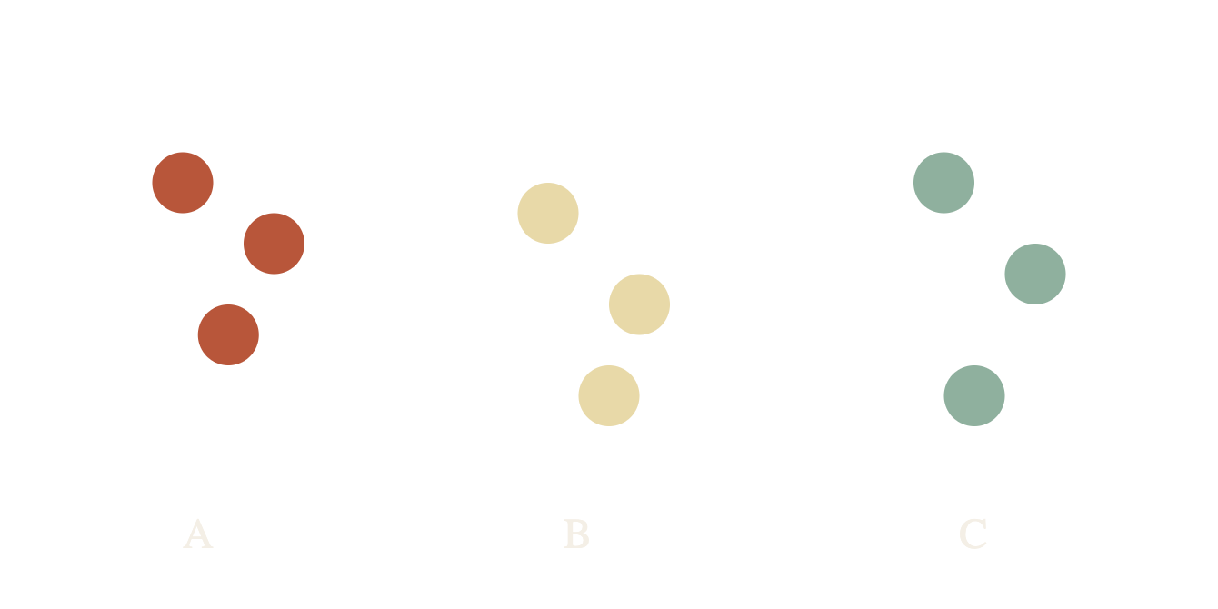
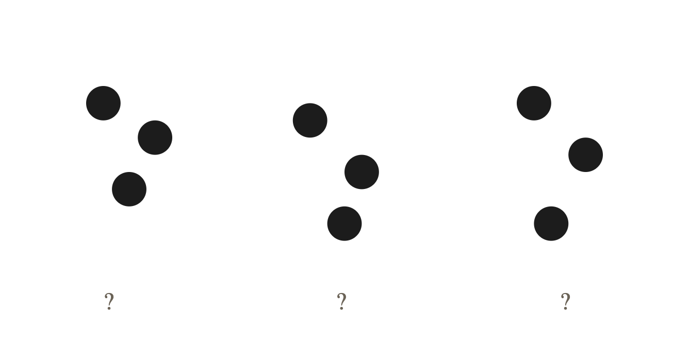
§ 03 · FOUNDATIONS
04 / 47
Supervised vs. unsupervised.
PARADIGM A
PARADIGM B
Supervised.
Unsupervised.
Labels exist. The model learns a mapping from features to a known target.
No labels. The model discovers structure — clusters, densities, projections — on its own.
classify · regress · predict
cluster · reduce · describe
Notes:
Compare the two paradigms side by side.

Slide 5
PART TWO
§ 03
Theory & taxonomy.
What a cluster is, what makes one good, and the three ways they can be organized.
05 / 47
Notes:
Section transition: theory of clustering.

Slide 6
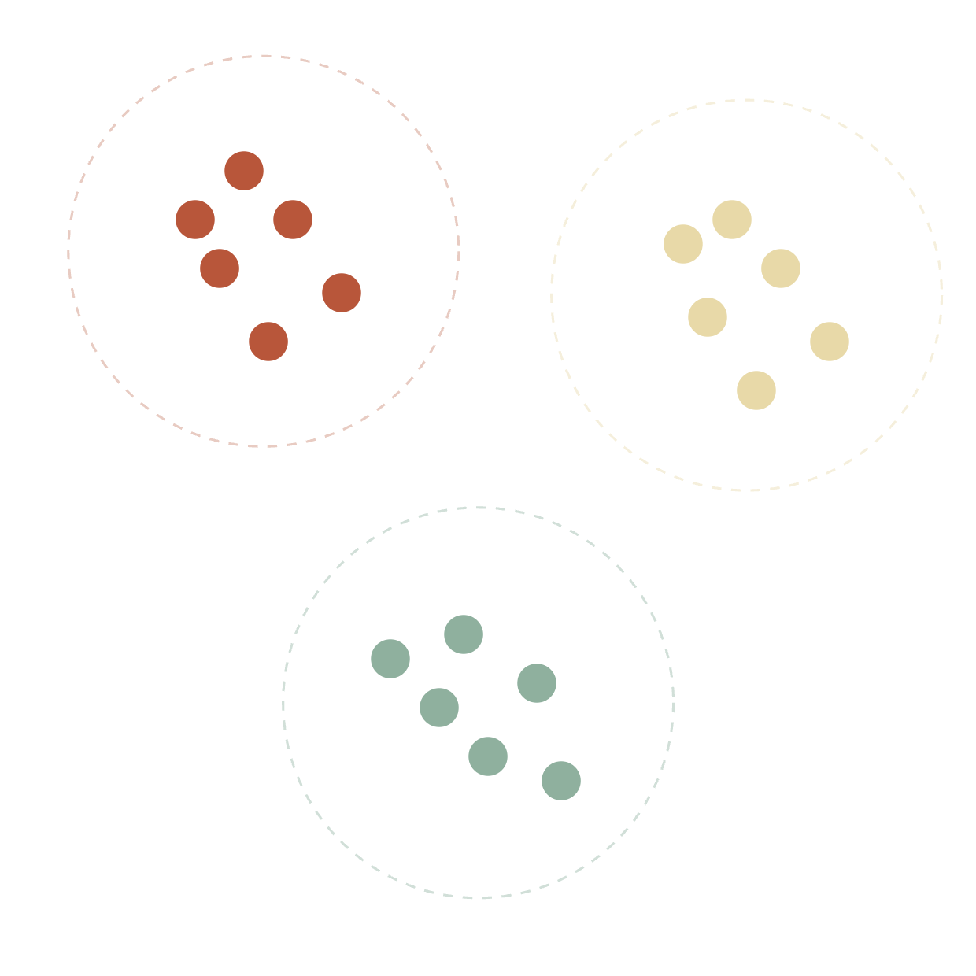
§ 03 · THEORY
06 / 47
What is cluster analysis?
— A CLUSTER IS
A group of data objects — similar to each other within, dissimilar across groups.
— CLUSTER ANALYSIS IS
The process of organizing data objects into clusters. A form of unsupervised classification — no predefined categories exist.
— COMMON USES
Independently, to understand data distribution
As a preliminary step for other algorithms
Notes:
Define cluster analysis.

Slide 7
§ 03 · THEORY
07 / 47
The clustering model.
Three things it must do.
01
02
03
Measure similarity
Detect groups
Reveal a summary
Provide a way to compare items in a collection of unlabelled data — usually via a distance metric.
Find groupings that satisfy a quality criterion — for instance, maximizing similarity within each cluster.
Function as a method to surface an informative, human-readable summary of the data.
Notes:
The clustering model at a high level.

Slide 8
§ 03 · THEORY
08 / 47
Clustering vs. classification.
Clustering
Classification
Used when the groups have not been identified beforehand.
Used when categories are already established — the goal is to place a new item accurately.
Notes:
Distinguish clustering from classification.

Slide 9
§ 03 · THEORY
09 / 47
Sample applications.
A few of the places clustering earns its keep.
MARKETING
FINANCE
BIOLOGY
OPERATIONS
Customer segmentation
Portfolio & risk grouping
Gene expression profiles
Anomaly detection
Targeted promotions from behavior
Country risk, asset baskets
Discovering functional groups
Fraud, quality, sensor drift
RETAIL
NLP
VISION
PREPROCESSING
Assortment planning
Topic discovery
Image segmentation
Data compression
Store archetypes
Document embeddings
Pixel & superpixel groups
Prototype substitutes
Notes:
Where clustering shows up in practice.

Slide 10
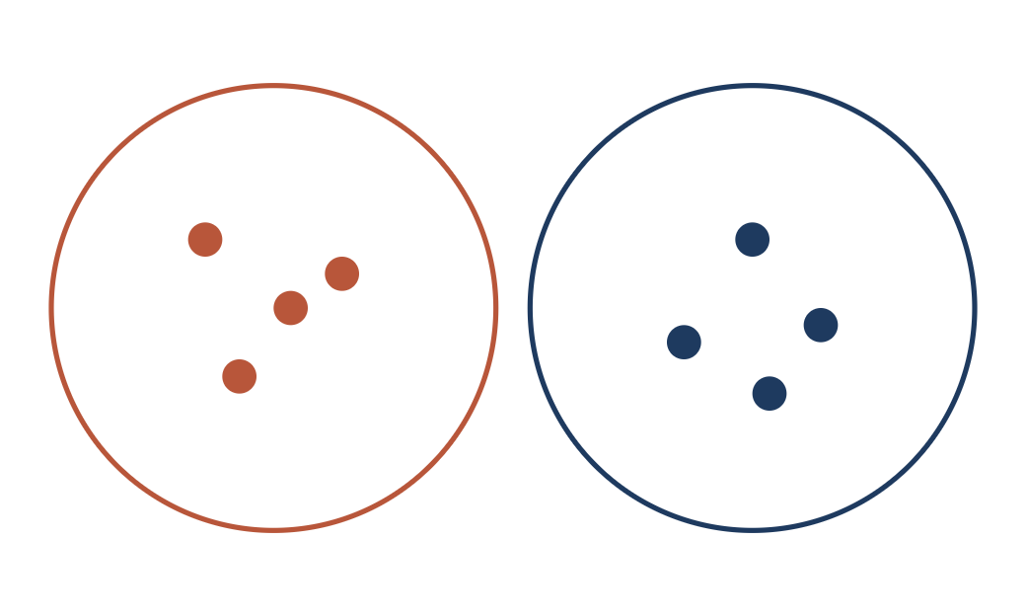
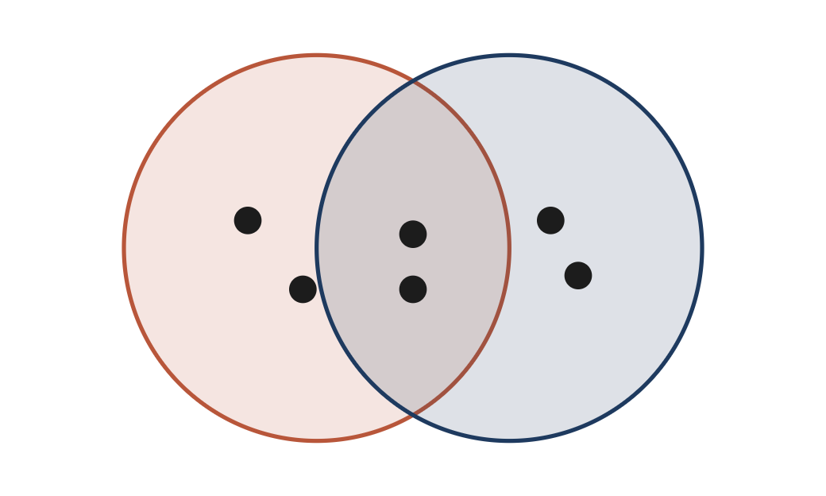
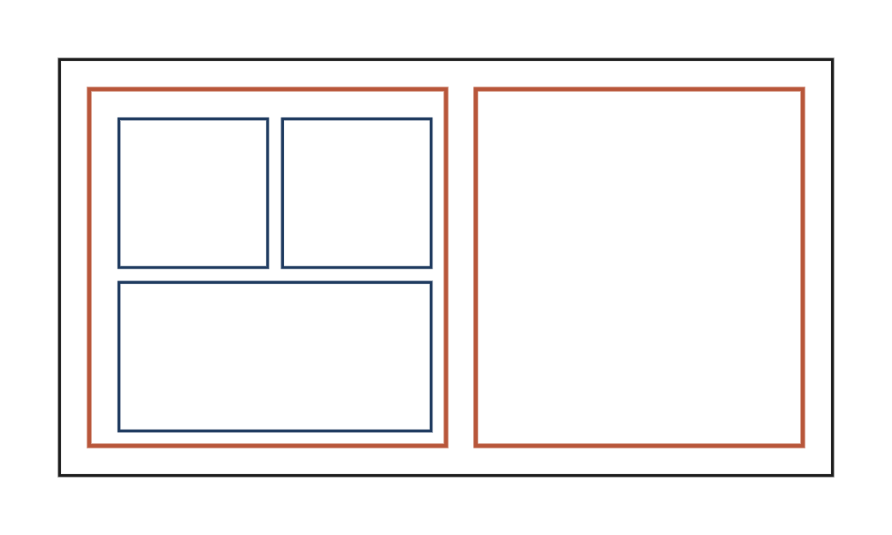
§ 03 · THEORY
10 / 47
Three techniques.
01 — EXCLUSIVE
02 — OVERLAPPING
03 — HIERARCHICAL
Strict partitioning
Shared membership
Nested clusters
Each data point is assigned to a single, unique cluster. The most widely used method.
Clusters can share points. A customer might be in both high-profit and high-volume.
Smaller child clusters combine into larger parents — e.g. long-term vs. new high-value customers.
Notes:
Three families of clustering methods.

Slide 11
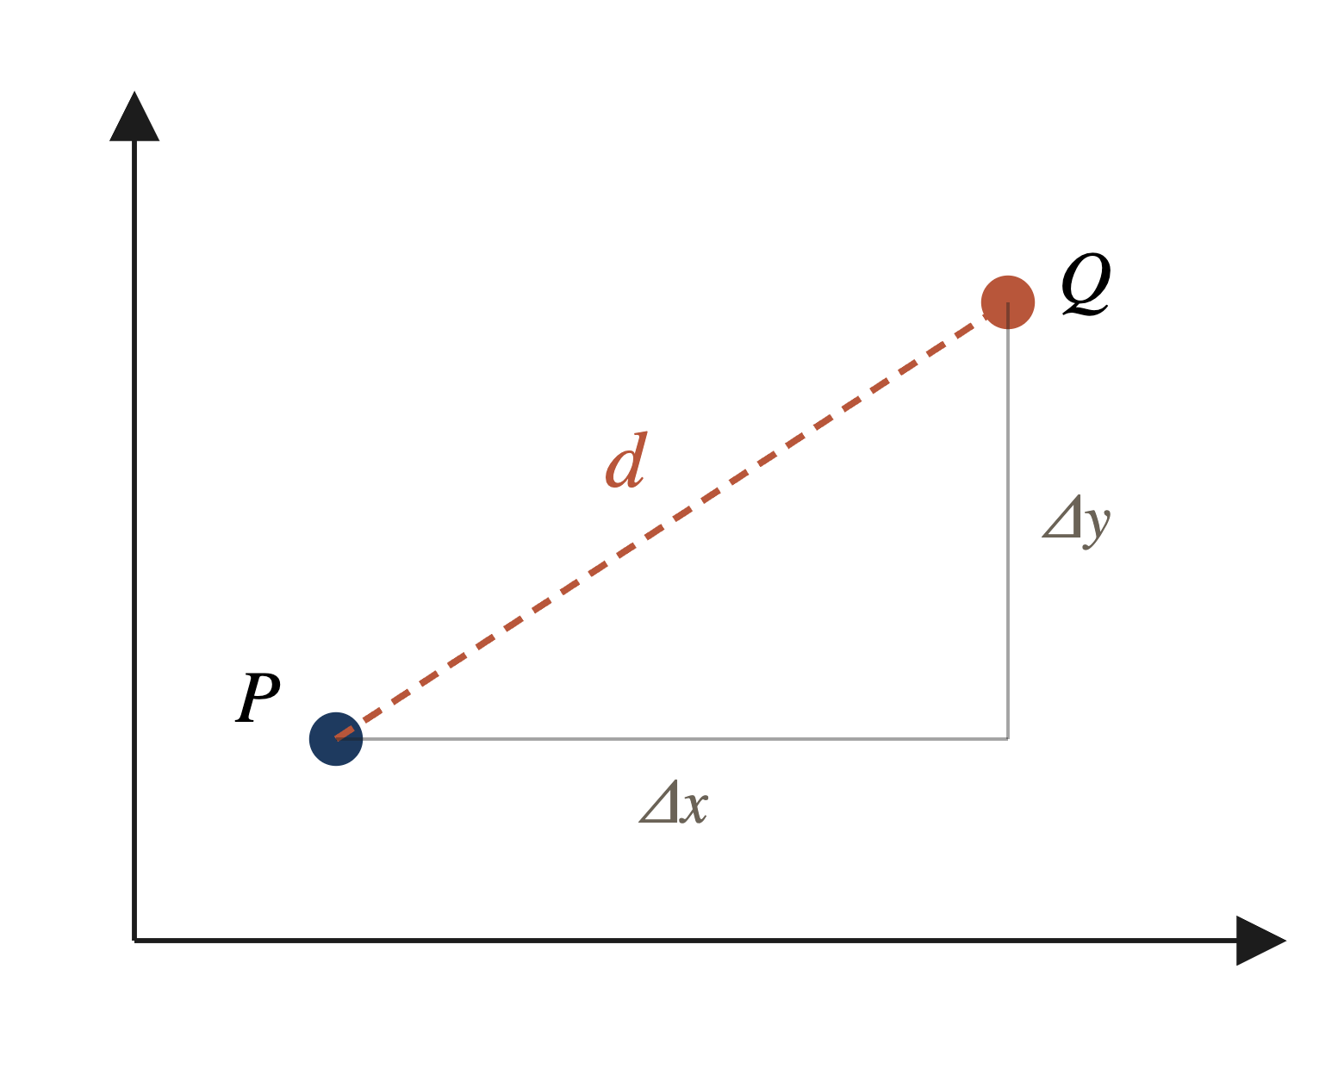
§ 04 · MECHANISM
11 / 47
A distance measure.
Clustering requires a way to measure distance.
The most basic distance metric is the Euclidean distance — the straight-line distance between two points.
d(P, Q) = √(x_{P}−x_{Q})² + (y_{P}−y_{Q})²
Hull · Machine Learning and Financial Institutions, 3rd Ed.
Notes:
How we measure closeness — Euclidean.

Slide 12
§ 04 · MECHANISM
12 / 47
Distance in m dimensions.
When there are m features, we sum the squared differences across every feature j.
d(P, Q) = √ Σ_{j=1}^{m} ( p_{j} − q_{j} )²
P_{J}, Q_{J}
M
Σ
The values of the j-th feature for points P and Q.
Number of features (dimensions of the feature space).
Sum of squared differences across every feature.
Hull · Machine Learning and Financial Institutions, 3rd Ed.
Notes:
Generalize to m features.

Slide 13
§ 04 · MECHANISM
13 / 47
Cluster centers.
The centroid of a cluster is found by averaging the values of each feature over the points in that cluster.
OBS
FEATURE 1
FEATURE 2
FEATURE 3
FEATURE 4
DIST. TO CENTER
1
1.00
1.00
0.40
0.25
0.145
2
0.80
1.20
0.25
0.40
0.258
3
0.82
1.05
0.35
0.50
0.206
4
1.10
0.80
0.21
0.23
0.303
5
0.85
0.90
0.37
0.27
0.137
Center
0.914
0.990
0.316
0.330
—
Hull · Machine Learning and Financial Institutions, 3rd Ed.
Notes:
Centroid = mean of feature values in the cluster.

Slide 14
§ 04 · MECHANISM
14 / 47
k-means clustering.
Looks for a fixed number of clusters, defined by proximity of data points to each other.
HOW IT WORKS
01
Select K data points at random as initial cluster centers.
LOOP
02
Assign every remaining point to one of the K clusters (via perpendicular bisector).
Choose k random points as centers
↓
03
Recompute the centroid of each cluster (mean of member points).
Assign each obs. to nearest center
↓
04
Use distance — Euclidean, Manhattan, or Minkowski.
Recalculate cluster centers
05
Exclusive partitioning — clusters do not overlap.
↓
Centers changed? ⟶ yes: loop
↓ no
End
Notes:
Introduce k-means as an exclusive partitioning method.

Slide 15
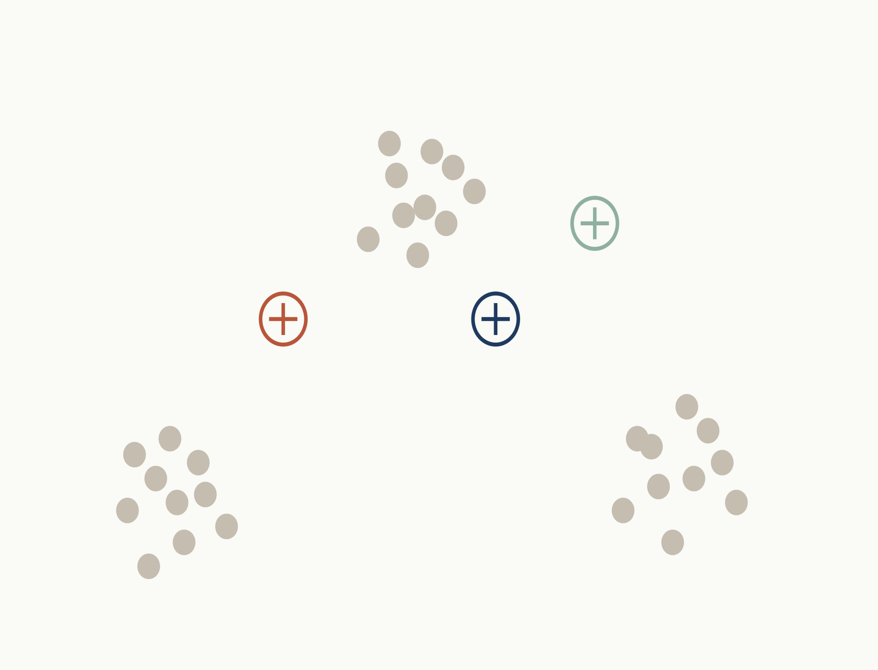
§ 04 · MECHANISM · K-MEANS WALK-THROUGH
15 / 47
k-means algorithm.
ITERATION 0 · INIT
TRAINING DATA
01
Select inputs.
02
Select k cluster centers.
03
Assign cases to closest center.
04
Update cluster centers.
05
Re-assign cases.
06
Repeat steps 4 & 5 until convergence.
NOW
Initialize — pick 3 random centers
Notes:
Initialize — pick 3 random centers

Slide 16
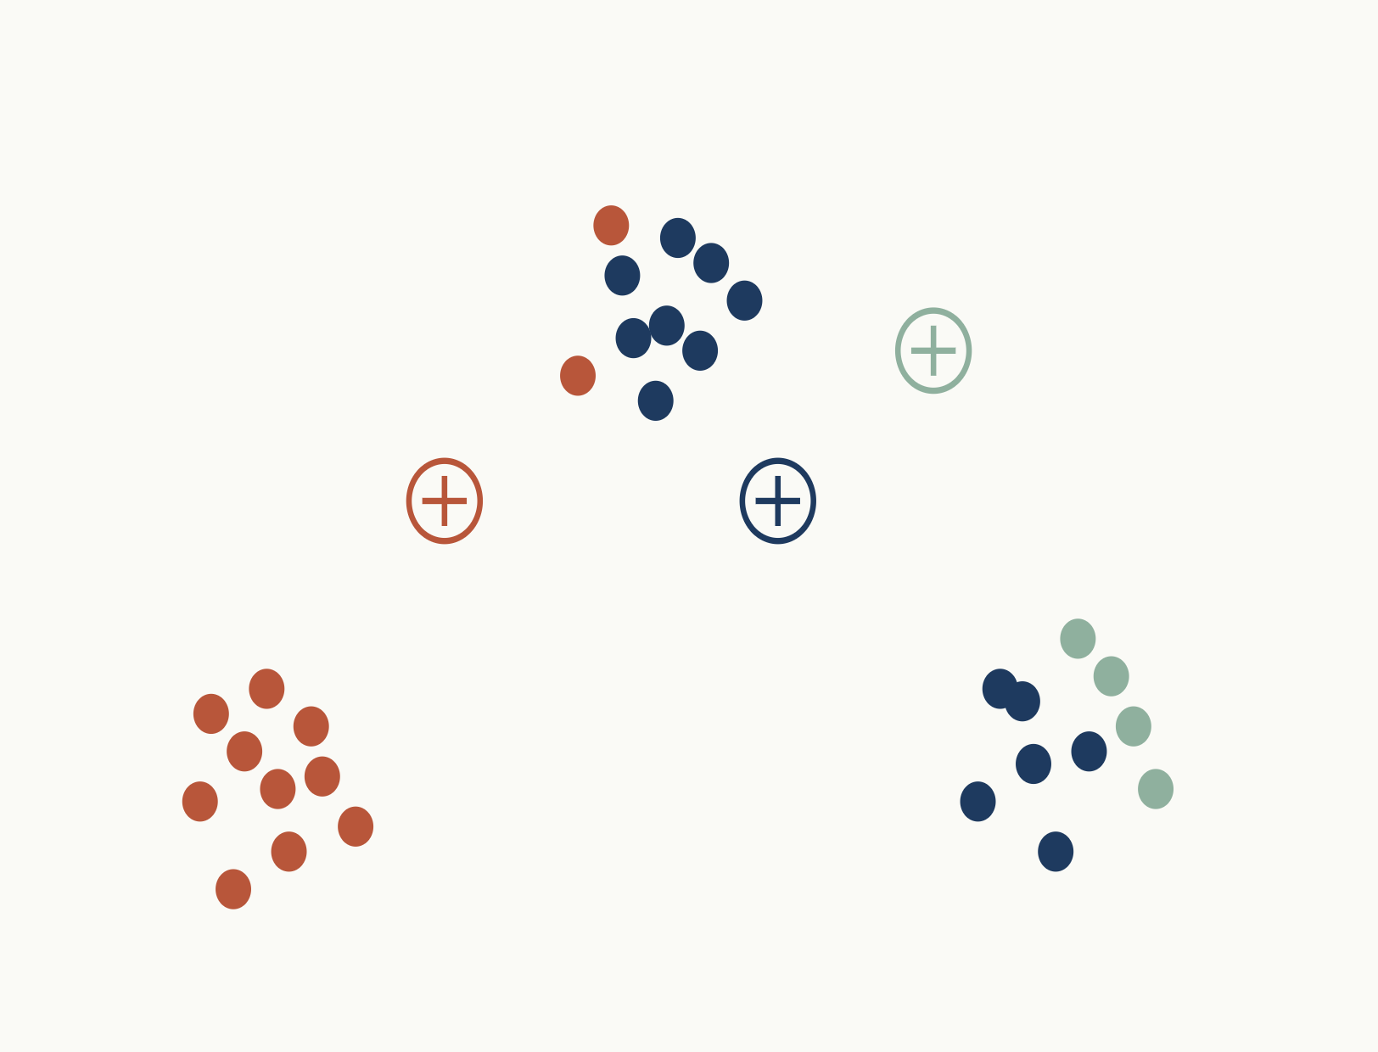
§ 04 · MECHANISM · K-MEANS WALK-THROUGH
16 / 47
k-means algorithm.
ITERATION 1
TRAINING DATA
01
Select inputs.
02
Select k cluster centers.
03
Assign cases to closest center.
04
Update cluster centers.
05
Re-assign cases.
06
Repeat steps 4 & 5 until convergence.
NOW
Assign — each point → nearest center
Notes:
Assign — each point → nearest center

Slide 17
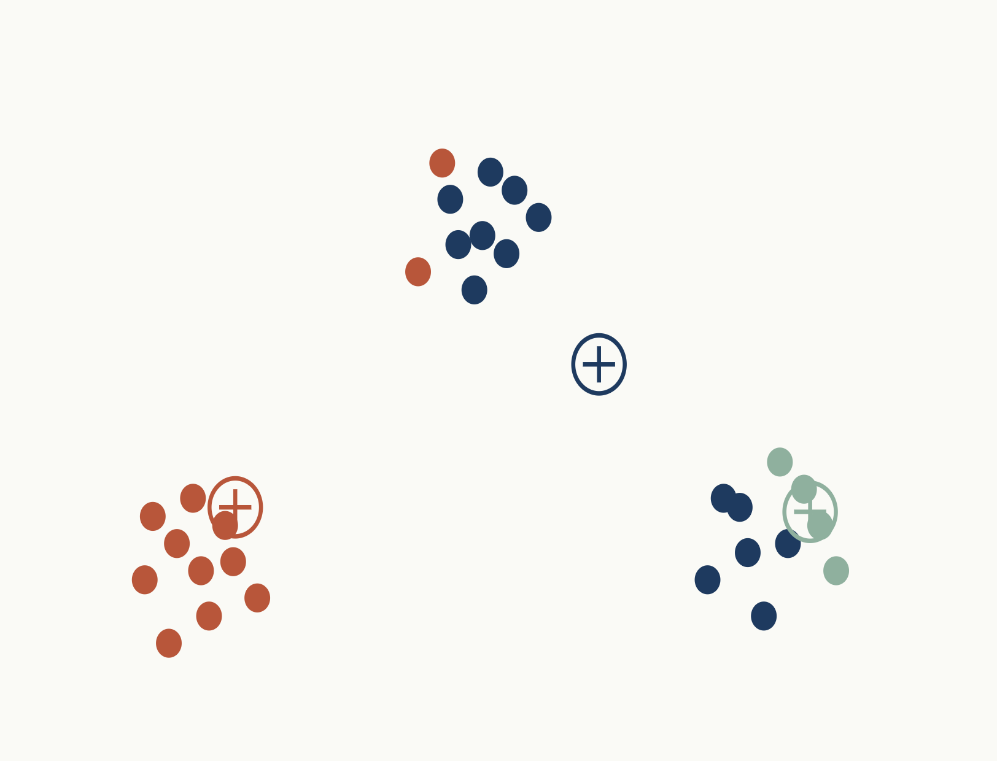
§ 04 · MECHANISM · K-MEANS WALK-THROUGH
17 / 47
k-means algorithm.
ITERATION 1
TRAINING DATA
01
Select inputs.
02
Select k cluster centers.
03
Assign cases to closest center.
04
Update cluster centers.
05
Re-assign cases.
06
Repeat steps 4 & 5 until convergence.
NOW
Update — recompute centers as means
Notes:
Update — recompute centers as means

Slide 18
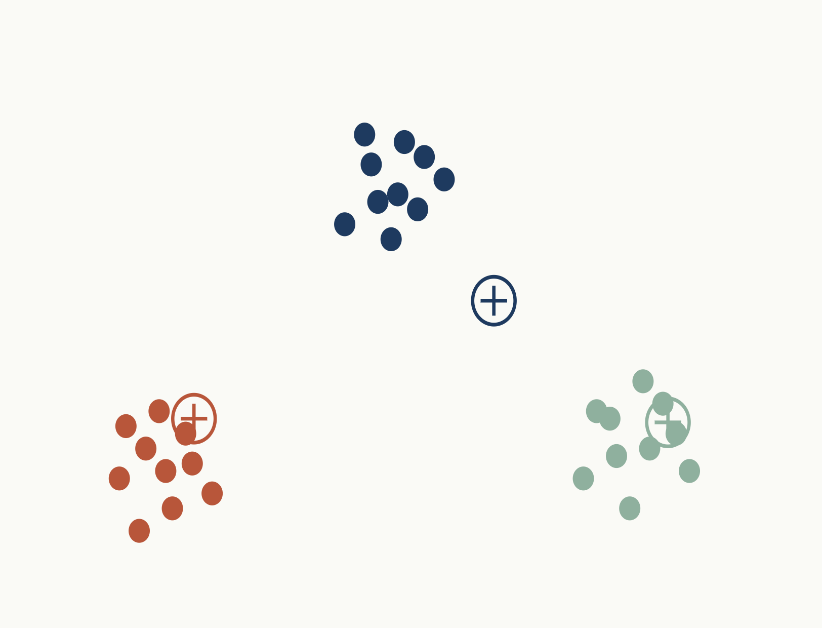
§ 04 · MECHANISM · K-MEANS WALK-THROUGH
18 / 47
k-means algorithm.
ITERATION 2
TRAINING DATA
01
Select inputs.
02
Select k cluster centers.
03
Assign cases to closest center.
04
Update cluster centers.
05
Re-assign cases.
06
Repeat steps 4 & 5 until convergence.
NOW
Reassign — with new centers
Notes:
Reassign — with new centers

Slide 19
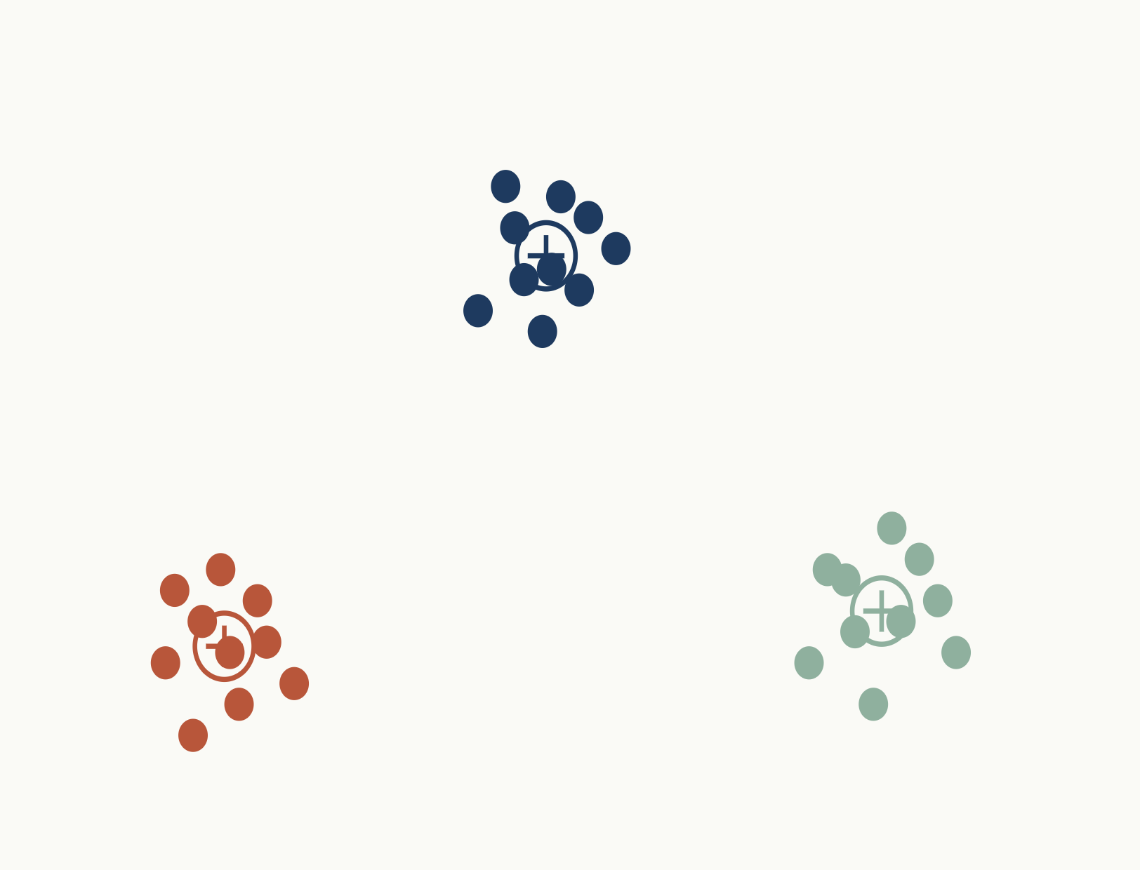
§ 04 · MECHANISM · K-MEANS WALK-THROUGH
19 / 47
k-means algorithm.
ITERATION 2
TRAINING DATA
01
Select inputs.
02
Select k cluster centers.
03
Assign cases to closest center.
04
Update cluster centers.
05
Re-assign cases.
06
Repeat steps 4 & 5 until convergence.
NOW
Update — recompute centers as means
Notes:
Update — recompute centers as means

Slide 20
§ 04 · MECHANISM · K-MEANS WALK-THROUGH
20 / 47
k-means algorithm.
ITERATION 3
TRAINING DATA
01
Select inputs.
02
Select k cluster centers.
03
Assign cases to closest center.
04
Update cluster centers.
05
Re-assign cases.
06
Repeat steps 4 & 5 until convergence.
NOW
Reassign — with new centers
Notes:
Reassign — with new centers

Slide 21
§ 04 · MECHANISM · K-MEANS WALK-THROUGH
21 / 47
k-means algorithm.
ITERATION 3
TRAINING DATA
01
Select inputs.
02
Select k cluster centers.
03
Assign cases to closest center.
04
Update cluster centers.
05
Re-assign cases.
06
Repeat steps 4 & 5 until convergence.
NOW
Update — recompute centers as means
Notes:
Update — recompute centers as means

Slide 22
§ 04 · MECHANISM · K-MEANS WALK-THROUGH
22 / 47
k-means algorithm.
ITERATION 4
TRAINING DATA
01
Select inputs.
02
Select k cluster centers.
03
Assign cases to closest center.
04
Update cluster centers.
05
Re-assign cases.
06
Repeat steps 4 & 5 until convergence.
NOW
Reassign — with new centers
Notes:
Reassign — with new centers

Slide 23
§ 04 · MECHANISM · K-MEANS WALK-THROUGH
23 / 47
k-means algorithm.
ITERATION 4
TRAINING DATA
01
Select inputs.
02
Select k cluster centers.
03
Assign cases to closest center.
04
Update cluster centers.
05
Re-assign cases.
06
Repeat steps 4 & 5 until convergence.
NOW
Update — small shifts
Notes:
Update — small shifts

Slide 24
§ 04 · MECHANISM · K-MEANS WALK-THROUGH
24 / 47
k-means algorithm.
ITERATION 5
TRAINING DATA
01
Select inputs.
02
Select k cluster centers.
03
Assign cases to closest center.
04
Update cluster centers.
05
Re-assign cases.
06
Repeat steps 4 & 5 until convergence.
NOW
Reassign — mostly stable
Notes:
Reassign — mostly stable

Slide 25
§ 04 · MECHANISM · K-MEANS WALK-THROUGH
25 / 47
k-means algorithm.
ITERATION 5
TRAINING DATA
01
Select inputs.
02
Select k cluster centers.
03
Assign cases to closest center.
04
Update cluster centers.
05
Re-assign cases.
06
Repeat steps 4 & 5 until convergence.
NOW
Update — small shifts
Notes:
Update — small shifts

Slide 26
§ 04 · MECHANISM · K-MEANS WALK-THROUGH
26 / 47
k-means algorithm.
ITERATION 6
TRAINING DATA
01
Select inputs.
02
Select k cluster centers.
03
Assign cases to closest center.
04
Update cluster centers.
05
Re-assign cases.
06
Repeat steps 4 & 5 until convergence.
NOW
Reassign — mostly stable
Notes:
Reassign — mostly stable

Slide 27
§ 04 · MECHANISM · K-MEANS WALK-THROUGH
27 / 47
k-means algorithm.
ITERATION 6
TRAINING DATA
01
Select inputs.
02
Select k cluster centers.
03
Assign cases to closest center.
04
Update cluster centers.
05
Re-assign cases.
06
Repeat steps 4 & 5 until convergence.
NOW
Update — negligible movement
Notes:
Update — negligible movement

Slide 28
§ 04 · MECHANISM · K-MEANS WALK-THROUGH
28 / 47
k-means algorithm.
ITERATION 7
TRAINING DATA
01
Select inputs.
02
Select k cluster centers.
03
Assign cases to closest center.
04
Update cluster centers.
05
Re-assign cases.
06
Repeat steps 4 & 5 until convergence.
NOW
Reassign — no changes
Notes:
Reassign — no changes

Slide 29
§ 04 · MECHANISM · K-MEANS WALK-THROUGH
29 / 47
k-means algorithm.
ITERATION 7
TRAINING DATA
01
Select inputs.
02
Select k cluster centers.
03
Assign cases to closest center.
04
Update cluster centers.
05
Re-assign cases.
06
Repeat steps 4 & 5 until convergence.
NOW
Converged — assignments stable
Notes:
Converged — assignments stable

Slide 30
§ 05 · CHOOSING K
30 / 47
Inertia.
For any given k the objective is to minimize inertia — the within-cluster sum of squares.
Inertia = Σ_{i} d_{i}²
d_{i} is the distance of observation i from its cluster center.
In practice, run k -means from several different starting points and keep the result with the smallest inertia.
Hull · Machine Learning and Financial Institutions, 3rd Ed.
Notes:
Objective function of k-means: within-cluster sum of squares.

Slide 31
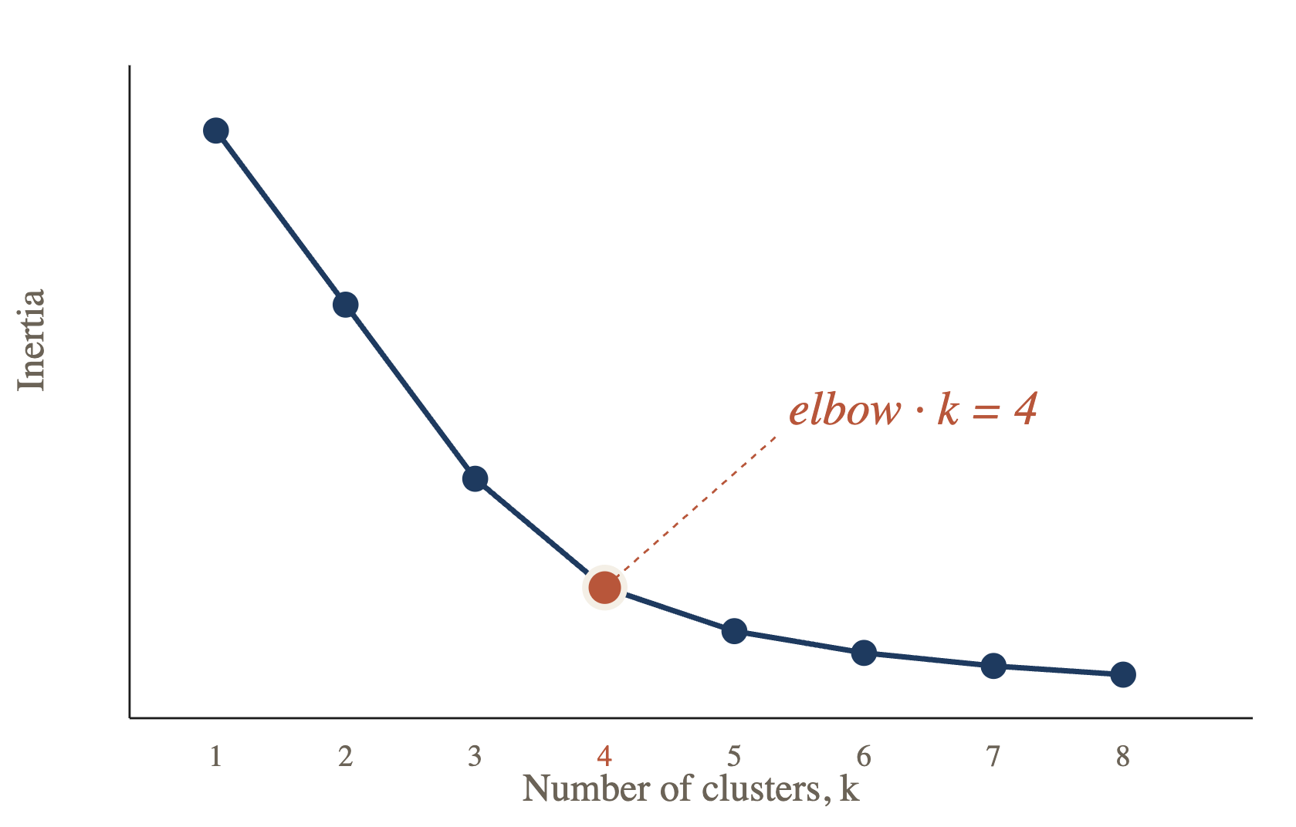
§ 05 · CHOOSING K
31 / 47
Choosing k — the elbow.
Plot inertia against k. Choose the point where the curve visibly bends — the marginal reduction in inertia flattens.
RULE OF THUMB
Pick the smallest k that captures most of the reduction — beyond the elbow, each new cluster buys diminishing returns.
IN THIS EXAMPLE
k = 4 is suggested.
Hull · Machine Learning and Financial Institutions, 3rd Ed.
Notes:
Elbow method — pick k where marginal improvement drops off.

Slide 32
§ 05 · CHOOSING K
32 / 47
The silhouette method.
For each observation i, compare its typical distance to its own cluster with its distance to the next-closest one.
DEFINITIONS
a(i) — average distance from other observations in i's own cluster.
b(i) — average distance from observations in the closest other cluster.
READING THE SCORE
≈ +1
Well-clustered; far from neighbors.
s(i) = b(i) − a(i) max{ a(i), b(i) }
≈ 0
On a cluster boundary.
≈ −1
Likely assigned to the wrong cluster.
ALTERNATIVE
Choose the number of clusters that maximizes the average silhouette score across all observations.
Use the gap statistic — compare within-cluster sum of squares to what would be expected on random data.
Notes:
Silhouette method and gap statistic.

Slide 33
PART THREE · CASE STUDY
§ 06
The mall customer case.
A well-known dataset from business DS / AI competitions — a good playground for segmentation.
kaggle.com / datasets shwetabh123 / mall-customers 33 / 47
Notes:
Introduce the mall customer dataset.

Slide 34
§ 06 · MALL CUSTOMERS
34 / 47
Why cluster them?
Mall owners want to segment shoppers by the data they already have.
AVAILABLE SIGNALS
EXAMPLE PLAYS
Age
demographic
Game days
High spenders receive discounts on premium sports apparel.
Annual income
$ k / year
Mother's / Father's Day
Young adults are prompted to purchase gifts for parents.
Prior spending
score 1–100
Valentine's Day
Promotions target young adults for partner gifts.
Stores can send targeted promotions to specific segments on the right days.
Notes:
Business motivation for segmenting mall customers.

Slide 35
§ 06 · MALL CUSTOMERS
35 / 47
Steps in clustering.
01
02
03
04
05
06
Clean data
Standardize
Find optimal k
Cluster
Interpret
Load data
drop rows with missing vars
all variables to Z-scores
elbow + silhouette
fit K-means on sample
list differences between clusters
load → clean → scale → tune k → fit → interpret
Notes:
End-to-end pipeline.

Slide 36
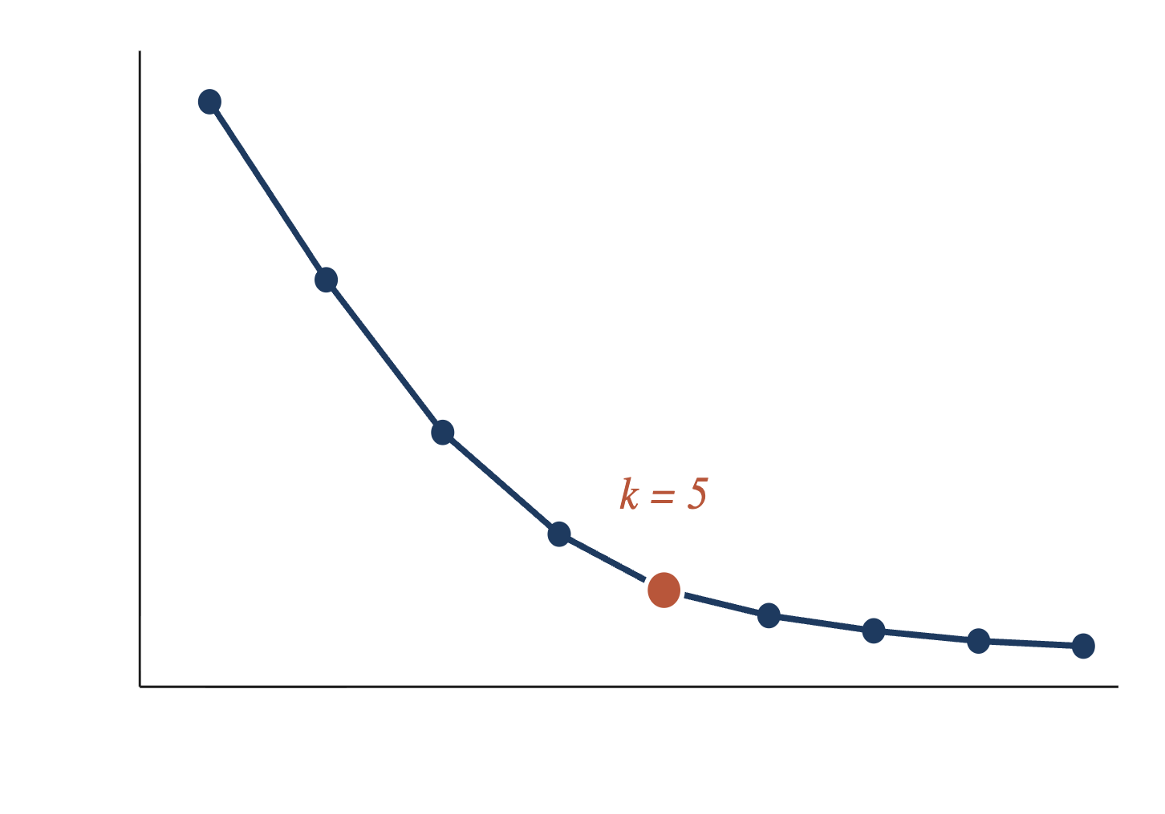
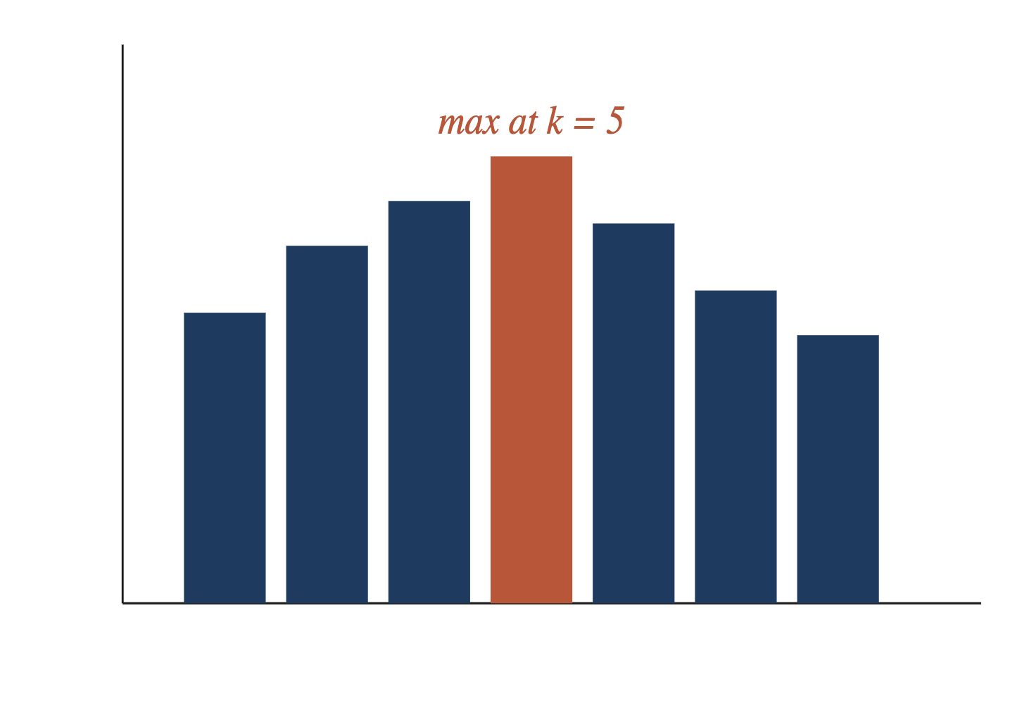
§ 06 · MALL CUSTOMERS
36 / 47
Elbow & silhouette.
ELBOW · WCSS VS. K
SILHOUETTE · AVERAGE SCORE
Both diagnostics agree — choose k = 5.
Notes:
Combined elbow and silhouette diagnostics on the mall dataset.

Slide 37
§ 06 · MALL CUSTOMERS
37 / 47
Fit the model.
Based on the diagnostics we use k = 5. Set a random state and a modest number of restarts for reproducibility.
# based on analysis, k = 5 works well (adjust as needed)
optimal_k = 5
# run k-means
kmeans = KMeans(
n_clusters=optimal_k,
random_state=42,
n_init=10,
)
cluster_labels = kmeans.fit_predict(X_scaled)
# random_state=42, n_init=10 → reproducible + robust initialization
Notes:
Run sklearn KMeans with k=5.

Slide 38
§ 06 · MALL CUSTOMERS
38 / 47
Cluster statistics.
Illustrative segment profiles from the fitted k = 5 model.
CLUSTER
NAME
N
AGE
INCOME ($K)
SPENDING
C1
Careful spenders
35
42.7
55.3
49.5
C2
Standard shoppers
42
32.7
86.5
82.1
C3
Target — young & rich
39
32.7
86.5
82.1
C4
Sensible high-earners
36
41.1
88.2
17.1
C5
Reckless spenders
23
25.3
25.7
79.4
Illustrative values · Hull · ML in Business
Notes:
Segment profiles from the fit.

Slide 39
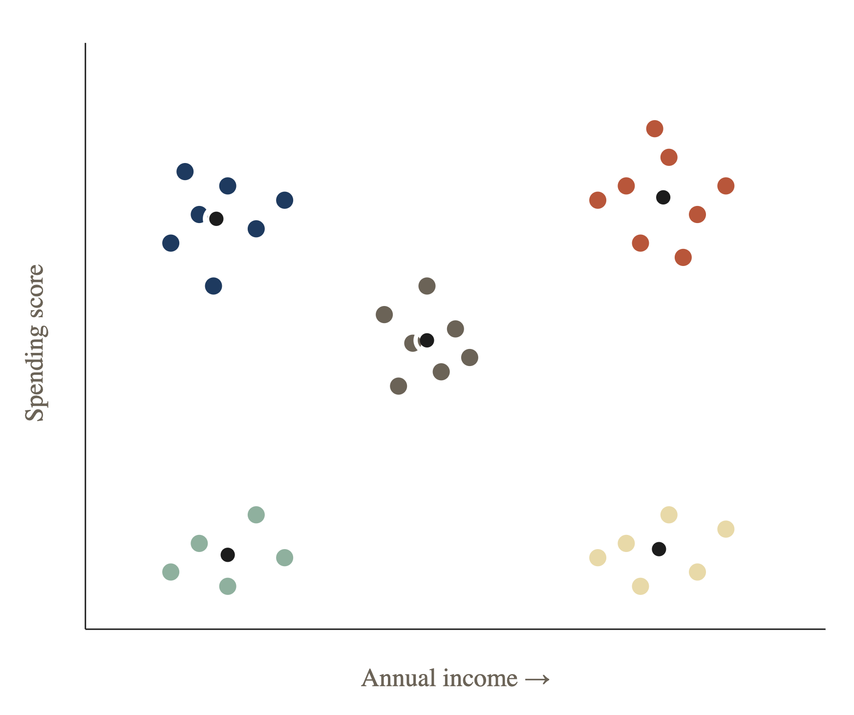
§ 06 · MALL CUSTOMERS
39 / 47
Cluster visualization.
Choose two variables and color points by their assigned cluster.
SEGMENTS
Low income · low spend
High income · low spend
Low income · high spend
High income · high spend
Average — the middle
Cluster centroid
Notes:
Plot the two variables you find most informative.

Slide 40
PART FOUR · CASE STUDY II
§ 07
Country risk.
Cluster countries by their riskiness for foreign investment using 2019 data.
01
02
03
04
GDP real growth rate
Corruption index
Peace index
Legal risk index
IMF
Transparency International
Inst. for Economics & Peace
Property Rights Assn.
121 countries · Z-score scaling
40 / 47
Notes:
Second case study — country risk clustering.

Slide 41
§ 07 · COUNTRY RISK
41 / 47
Part of the original data.
Raw, unscaled values — six of 121 countries.
COUNTRY
CORRUPTION
PEACE
LEGAL RISK
GDP GROWTH (%/YR)
Albania
35
1.821
4.546
2.983
Algeria
35
2.219
4.435
2.553
Argentina
45
1.989
5.087
−3.061
Armenia
42
2.294
4.812
6.000
Australia
77
1.419
8.363
1.713
Austria
77
1.291
8.089
1.605
Hull · Machine Learning and Financial Institutions, 3rd Ed.
Notes:
A slice of the raw dataset.

Slide 42
§ 07 · COUNTRY RISK
42 / 47
After Z-score scaling.
Each feature now has mean 0 and unit variance.
COUNTRY
CORRUPTION
PEACE
LEGAL RISK
GDP GROWTH
Albania
−0.633
−0.390
−0.878
0.127
Algeria
−0.633
0.472
−0.959
−0.041
Argentina
−0.099
−0.026
−0.484
−2.231
Armenia
−0.259
0.635
−0.685
1.304
Australia
1.612
−1.261
1.900
−0.368
Austria
1.612
−1.539
1.701
−0.411
Hull · Machine Learning and Financial Institutions, 3rd Ed.
Notes:
Same rows after Z-score standardization.

Slide 43
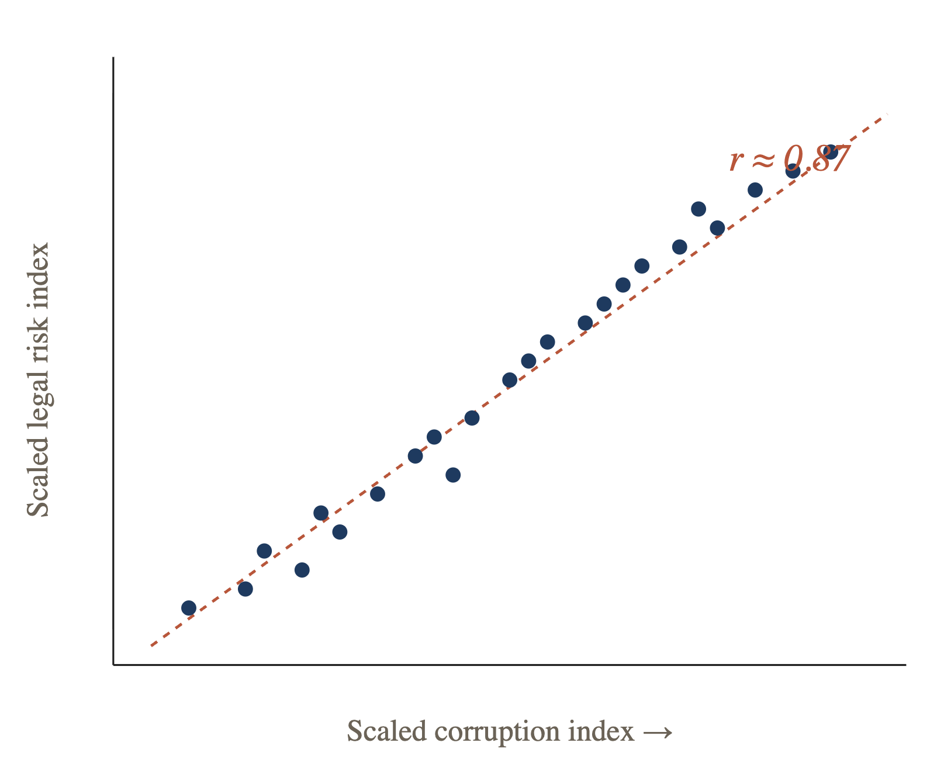
§ 07 · COUNTRY RISK
43 / 47
Corruption & legal risk were highly correlated.
DECISION
Redundant features add noise, not signal. Drop one.
FINAL FEATURE SET
GDP growth rate
Peace index
Legal risk index
Notes:
Drop corruption index — highly correlated with legal risk.

Slide 44
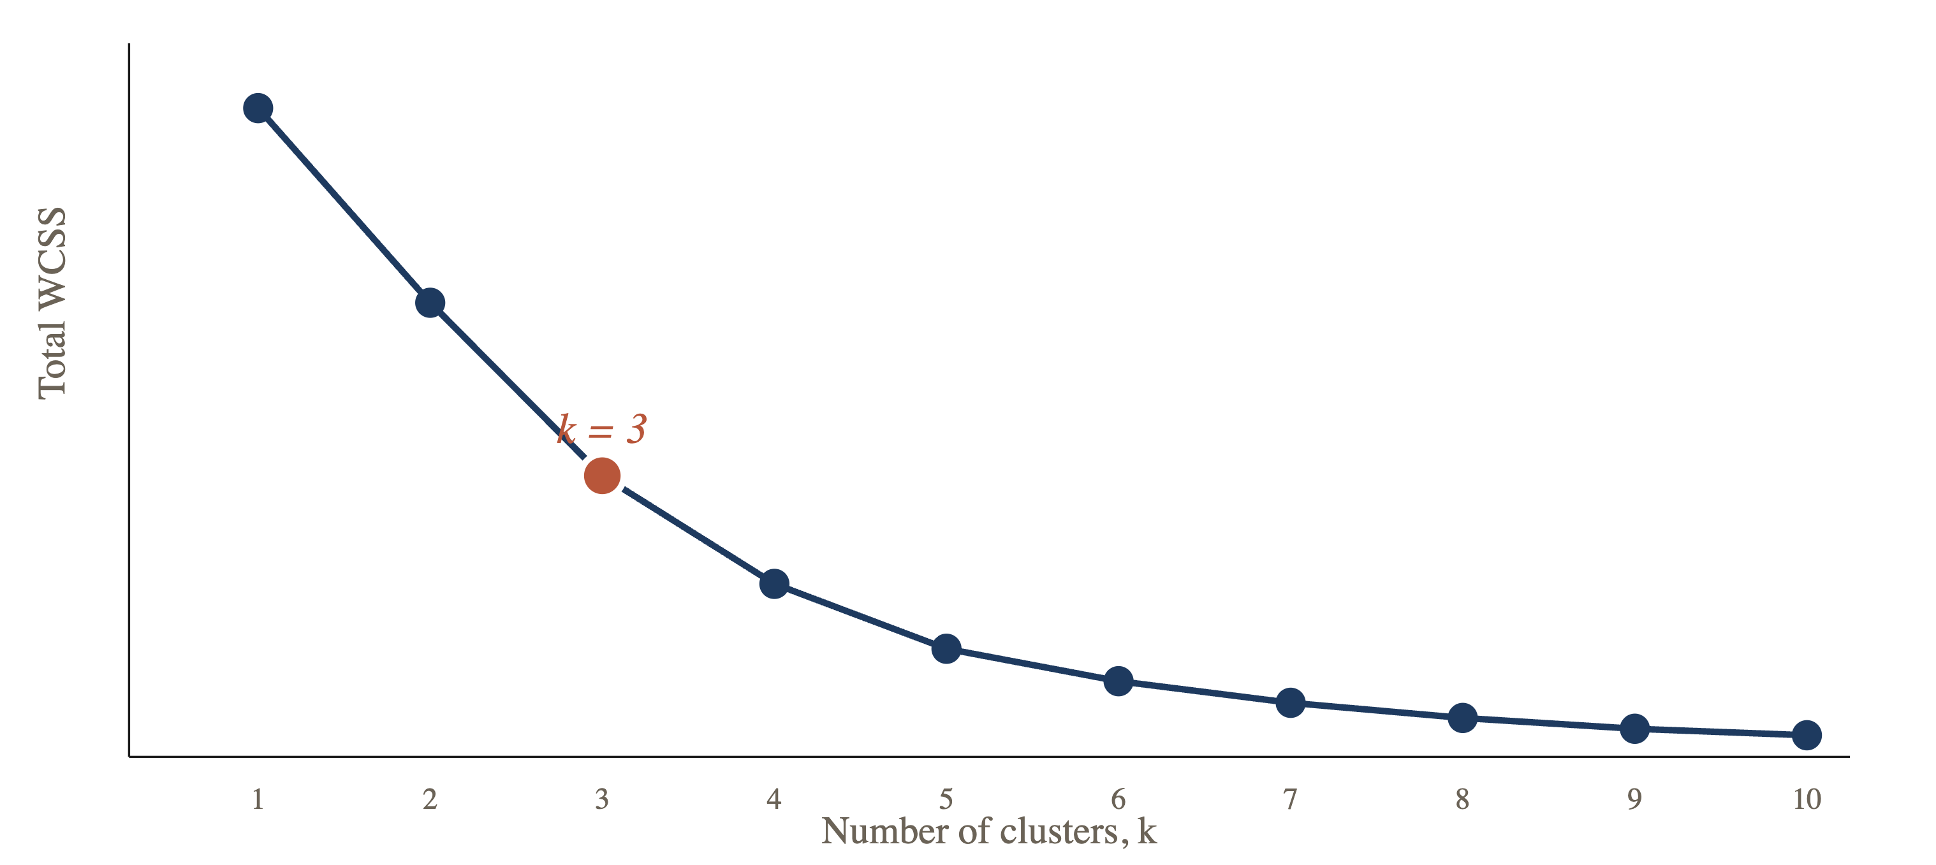
§ 07 · COUNTRY RISK
44 / 47
Within-cluster sum of squares vs. k.
How the total WCSS declines as k grows under k-means.
Hull · Machine Learning and Financial Institutions, 3rd Ed.
Notes:
Total within-cluster sum of squares as k grows.

Slide 45
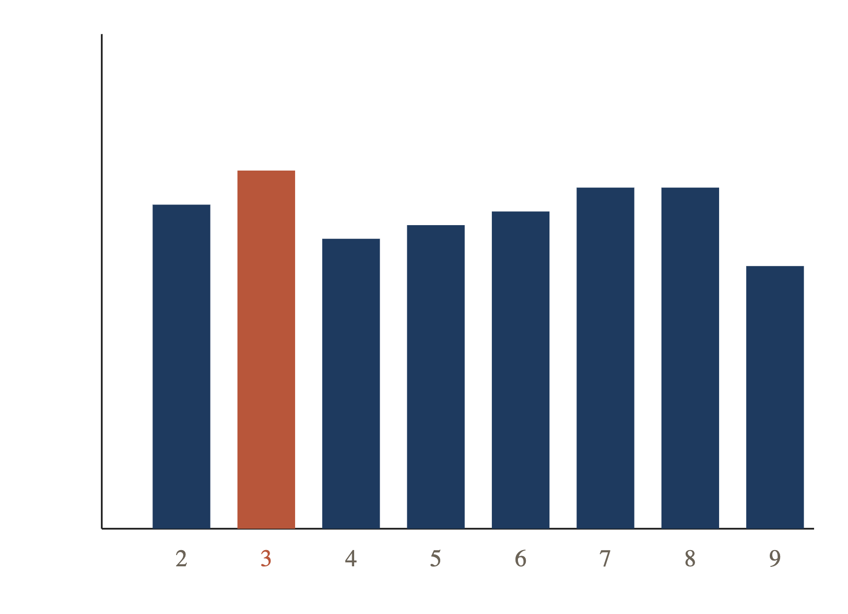
§ 07 · COUNTRY RISK
45 / 47
Silhouette scores.
Suggests k = 3.
K
AVG. SILHOUETTE
2
0.351
3
0.360
4
0.340
5
0.344
6
0.348
7
0.355
8
0.355
9
0.332
Hull · Machine Learning and Financial Institutions, 3rd Ed.
Notes:
Silhouette confirms k=3.

Slide 46
§ 07 · COUNTRY RISK
46 / 47
Cluster centers (scaled).
Note: high peace-index values are bad; high legal-risk-index values are good.
CLUSTER
PEACE INDEX
LEGAL INDEX
GDP
READING
High risk
1.35
−0.83
−1.11
unstable, weak law, contracting
Moderate risk
0.22
−0.55
0.60
mixed institutions, growing
Low risk
−0.85
1.02
−0.24
peaceful, rule of law, mature
Hull · Machine Learning and Financial Institutions, 3rd Ed.
Notes:
Interpret the three country risk clusters.

Slide 47
ISM 6642 · END OF LECTURE
47 / 47
TAKEAWAYS
Structure, without supervision.
01
02
03
Clustering finds groups when no labels exist.
k
k
-means minimizes inertia through iterative reassignment.
Elbow & silhouette diagnostics choose
; scaling matters.
INSTRUCTOR
— Questions?
Dr. Hemang Subramanian
Notes:
Wrap-up.

